Slide 1




Placing New Constraints on the Unexpectedly Complex Formation of Meteor Crater
Alexandra Huff
Mentors: Dr. Justin Hagerty and Tenielle Gaither

Slide 2
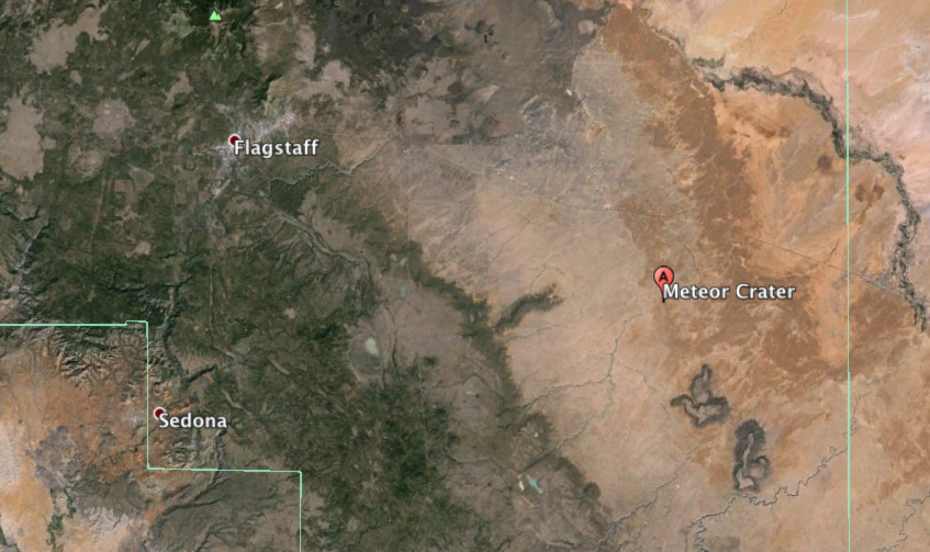
Barringer Meteorite Crater
N

Slide 3
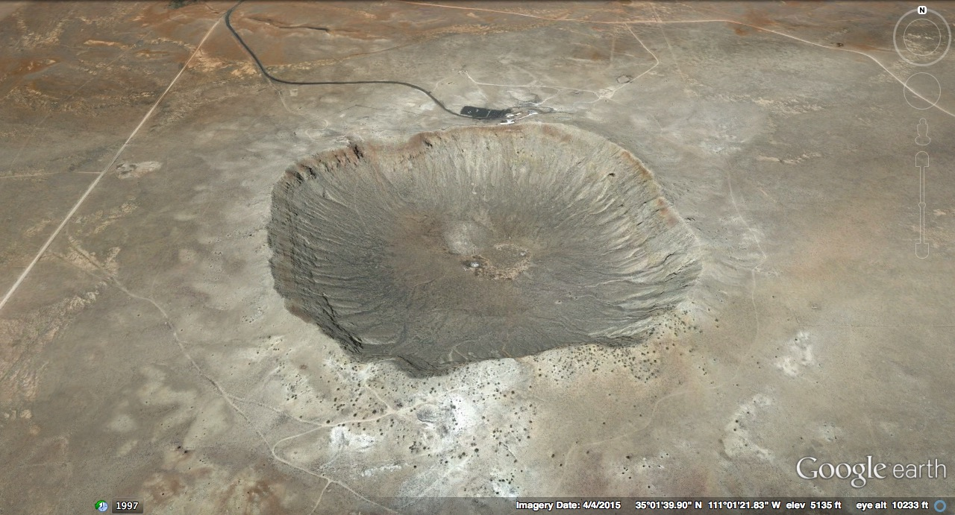
Barringer Meteorite Crater
N
N
Notes:
Needs a scale
40 miles east of flagstaff
-Canyon Diablo Meteorite crashed into Earth’s surface at 26,000 mph and formed crater just over a kilometer in diameter. (1.1 km)
-50,000 years old, best preserved crater on Earth and studied as the reference example for impact craters throughout the solar system

Slide 4
Formation of Meteor Crater
Ejecta Blanket

Slide 5
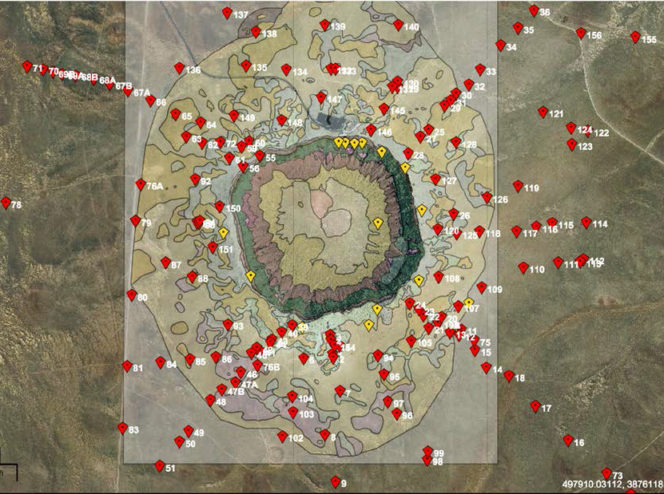
Meteor Crater Drill Hole Locations

Slide 6
Abbreviations
SEM – Scanning Electron Microscope
EDS – Energy Dispersive X-Ray Spectrometer
BSE – Back Scattered Electron
MMI – Metallic Melt Inclusions
BaSO₄ – Barium Sulfate
FeO – Iron Oxide

Slide 7
Constraining Points
Document if a change in Iron/Nickel composition occurs in MMIs compared with expected Canyon Diablo ratios
If there is a change in Iron/Nickel composition:
Does it correlate with depth or lateral location?
Does it depend on the size of the MMI?

Slide 8
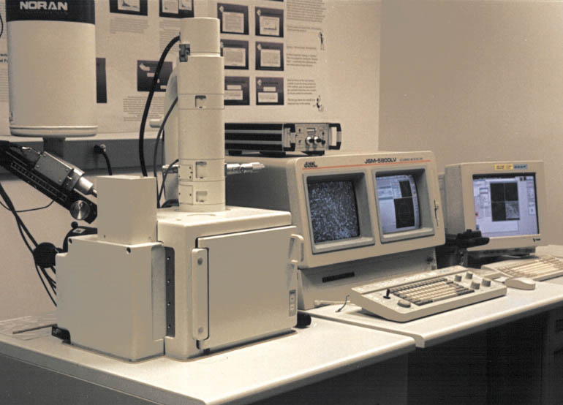
SEM Station

Slide 9
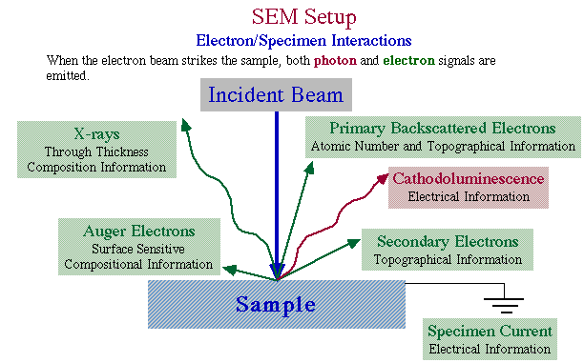
SEM Mechanics
http://antoine.frostburg.edu/engin/sem/Image5.gif

Slide 10
Brighter areas = atoms with HIGH atomic numbers
Darker areas = atoms with LOW atomic numbers
Black areas = void space, usually due to vesicles

Slide 11
BaSO₄
MMI13
MMI22
BaSO₄
BaSO₄
MMI21
BaSO₄
BaSO₄
BaSO₄

Slide 12
Vesicle
Quartz
MMIs
Glass

Slide 13
Quartz
Glass
FeO

Slide 14
FeO
MMI
MMI
Epoxy
(Sample mount material)
FeO

Slide 15
Notes:
** Weight percent on axes
93% Fe and 7% Ni (weight percent) From Canyon Diablo meteorite collected from ejecta blanket
Heterogeneous reaction taking place, impactor is being melted and ration of parent are being altered during impact process

Slide 16
Iron/Nickel to Size Binary
Notes:
Fe/Ni

Slide 18
Summary of Results
Iron to Nickel ratios vary across MMIs within a single sample
No dependence on depth or lateral location in ejecta blanket
Iron to Nickel ratios do not vary depending on size of the MMI
Darker phases within the MMIs contain relatively larger proportions of sulfur than measured for the Canyon Diablo Impactor

Slide 19
Meteor Crater Complexities
SEM analysis shows:
Individual MMIs are either compositionally uniform or non-uniform (i.e., they are two- or three-phase)
There is a Ni-rich phase (BSE-bright)
There is a S-rich phase (BSE-dark)
Textural relationships suggest exsolution of two immiscible liquids from an initially homogenous Canyon Diablo melt
This data will serve as preliminary findings for future investigation of notable areas
Notes:
This data will serve as preliminary findings for future investigation of notable areas

Slide 20
Thank You
NASA Space Grant
Dr. Nadine Barlow
Kathleen stigmon
U.S. Geological Survey Dr. Justin Hagerty Tenielle Gaither Amber Gullikson Dr. James Wittke
Notes:
Document if change
Document if change between depth/lateral location
Change based on size

Slide 21
Questions?

